Slide 1
ENERGY CONSUMPTION ANALYSIS

Slide 2
PROBLEM STATEMENT
Analyzing energy usage and GHG emissions of Ontario's Broader Public Sector (BPS) organizations.
Aiming on identifying trends, assess conservation effectiveness, and pinpoint areas for improvement
Informing data-driven strategies to achieve climate change mitigation goals within the BPS.

Slide 3
TOOLS USED:
Microsoft excel:
Initial check on dataset
Jupyter Notebook:
Python scripting
Data cleaning
EDA
Microsoft PowerBI:
Data visualization

Slide 4
Approaches:
Initial check of data set
Data loading
Checking for null values
Data cleaning
Exploratory Data Analysis:
Verifying column names
Dropping unwanted attributes
Conversion of categorical data to numerical data
Ensuring data quality and relevance
Converting the processed data frame to csv file in system.
Data visualization
Loaded the processed dataset into Power BI for intuitive and insightful visualizations.

Slide 5
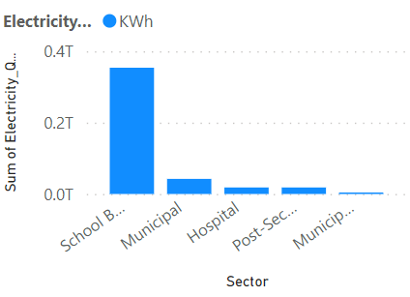
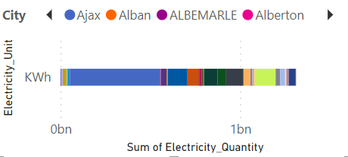
DATA DRIVEN INSIGHTS: (From 2012 to 2021)
Total electricity usage:436.91billion kWh
With maximum electricity consumption:
Sector : School board
City: Ajax

Slide 6
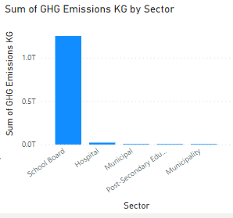
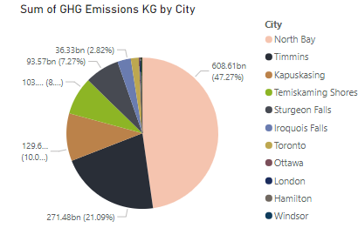
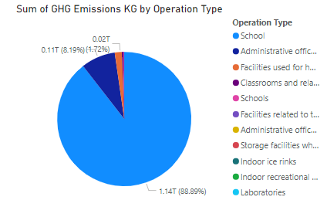
3.GHG emission:

Slide 7
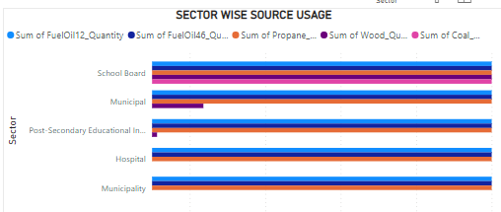
SECTOR WISE RESOURCE USAGE

Slide 8
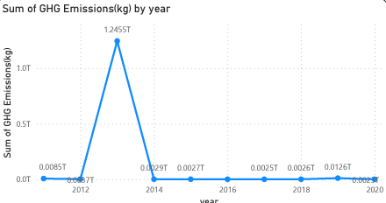
GHG EMISSION YEARWISE:
Found that 2013 has peaked in GHG emission
Despite variations in energy consumption, a consistent increase in greenhouse gas emissions

Slide 9
SUGGESTIONS:
Going through the energy revolution of 2013,2014
Continuous monitoring of city Ajax
Installing measures in school board, North bay city for less energy consumption from non-renewable resources
Basically installing measures all around sectors and cities that has crossed the threshold(mean value)

Slide 10
THANK YOU AND HAVE A GOOD DAY

